Slide 1

Recipe Site Traffic
Segun umoru

Slide 2

About Tasty Bytes
About Tasty Bytes Tasty Bytes was founded in 2020 amid the Covid Pandemic. The world wanted inspiration so we decided to provide it. We started life as a search engine for recipes, helping people find ways to use up the limited supplies they had at home. Now, over two years on, we are a fully-fledged business. For a monthly subscription, we will put together a full meal plan to ensure you and your family are getting a healthy, balanced diet whatever your budget. Subscribe to our premium plan and we will also deliver the ingredients to your door.

Slide 3

Business Goal
Predict which recipes will lead to high traffic.
Correctly predict high-traffic recipes 80% of the time.

Slide 4
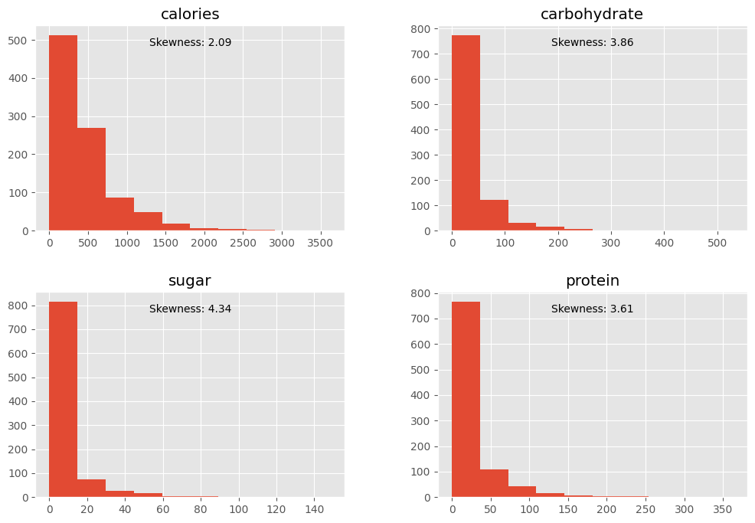
Distribution of Numerical Variables
The distribution of the variables calories, carbohydrate, sugar, and protein is skewed to the right. This indicates that the majority of people have higher values for these variables. Specifically, the skewness values are 2.09 for calories, 3.86 for carbohydrates, 4.34 for sugar, and 3.61 for protein.
Based on these skewness values, it can be inferred that most individuals consume calories above 435, carbohydrates above 35 grams, sugar above 9 grams, and protein above 24 grams in their diet.

Slide 5
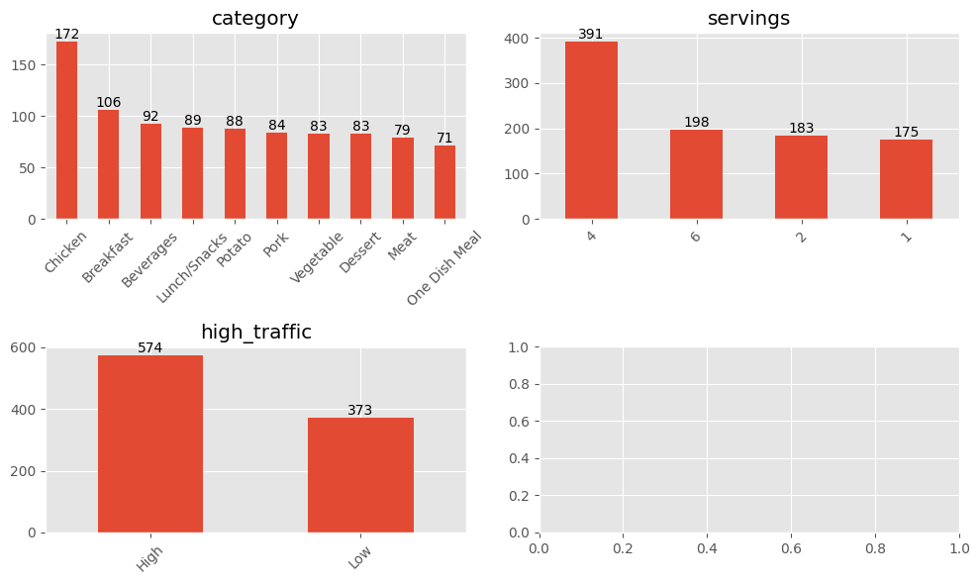
Distribution of Categorical Variables
The data shows that chicken recipes are the most popular, with a total count of 172, followed by breakfast recipes with a total count of 106. One Dish Meal recipes are the least popular, with a total count of 71.
Regarding serving sizes, it appears that 4 servings are the most preferred, with a total count of 391, followed by 6 servings with a total count of 198. The least preferred serving size is 1 serving, with a total count of 175.
In terms of website traffic, there were 574 high-traffic and 373 low-traffic views when the recipe was shown.

Slide 6
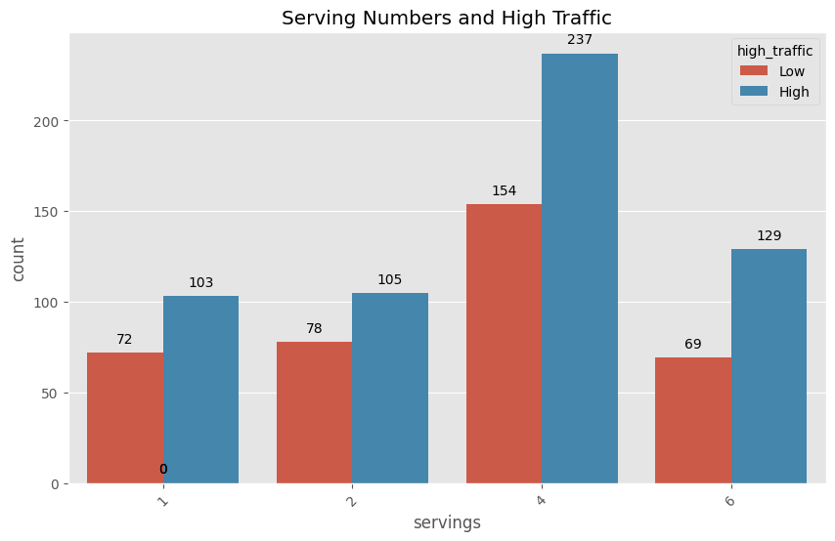
Serving Numbers and High Traffic
For each serving, the number of recipes with high traffic is more than the number of recipes with low traffic, so this feature doesn’t have a big influence on the target variable.

Slide 7
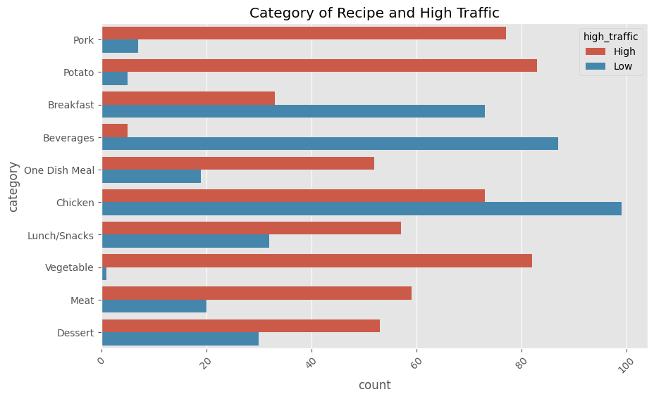
Category of Recipe and High Traffic
Potato, Pork, and Vegetable categories have a higher number of recipes with high traffic than with low traffic.
One Dish Meal, Lunch/Snacks, Meat, and Dessert categories have just more recipes with high traffic than with low traffic.

Slide 8
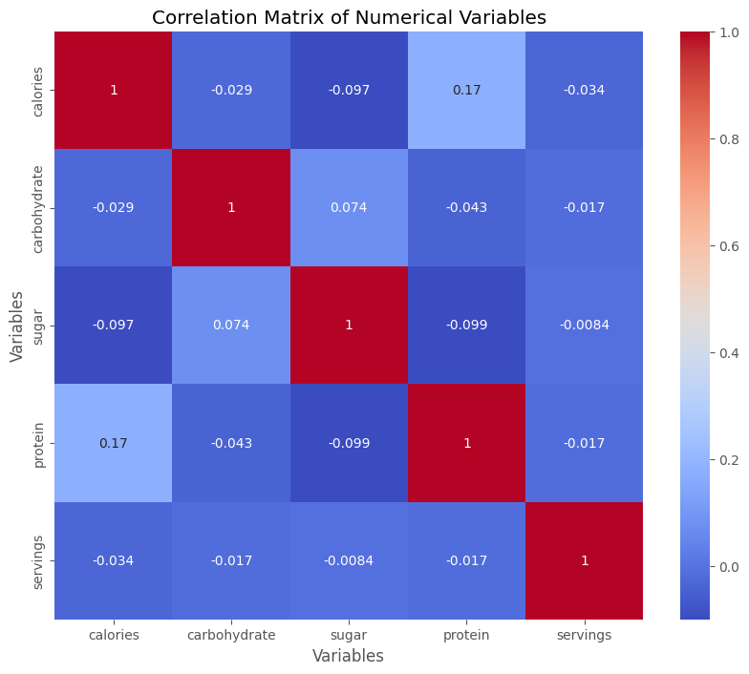
Correlation Matrix of Numerical Variables
There is a very slight positive correlation between sugar and carbohydrate with a coefficient of 0.074 while protein and calories shows a slight correlation with a coefficient of 0.17.

Slide 9

Business Focus & Metrics
There are 2 business goals:
to predict which recipes will be with high traffic;
to predict the "High" value of traffic of the recipes with 80% probability.
The Logistic Regression model has achieved both goals, because it has high rates of Precision and recall, and F1 Scores are more or equal to 80%.

Slide 10

Business Recommendations
To aid the Product Manager in predicting recipe traffic, deploying the Logistic Regression Model in production can ensure approximately 84% accuracy in identifying high-traffic recipes. This will instill confidence in the Product Manager to drive more traffic to the website. Additionally, the Product Manager can consider the following strategies:
Personalized Meal Plans: Utilize nutritional data to create personalized meal plans based on individual preferences and dietary needs.
Promote Popular Categories: Emphasize and expand promotion of popular recipe categories, particularly chicken recipes, by introducing new and innovative options to maintain customer engagement.
To focus marketing efforts, target high-traffic recipe categories like Potato, Pork, and Vegetable.
Additionally, optimize serving size options by aligning them with customer preferences and highlighting recipes that cater to popular serving sizes, such as 4 servings.

